Slide 1
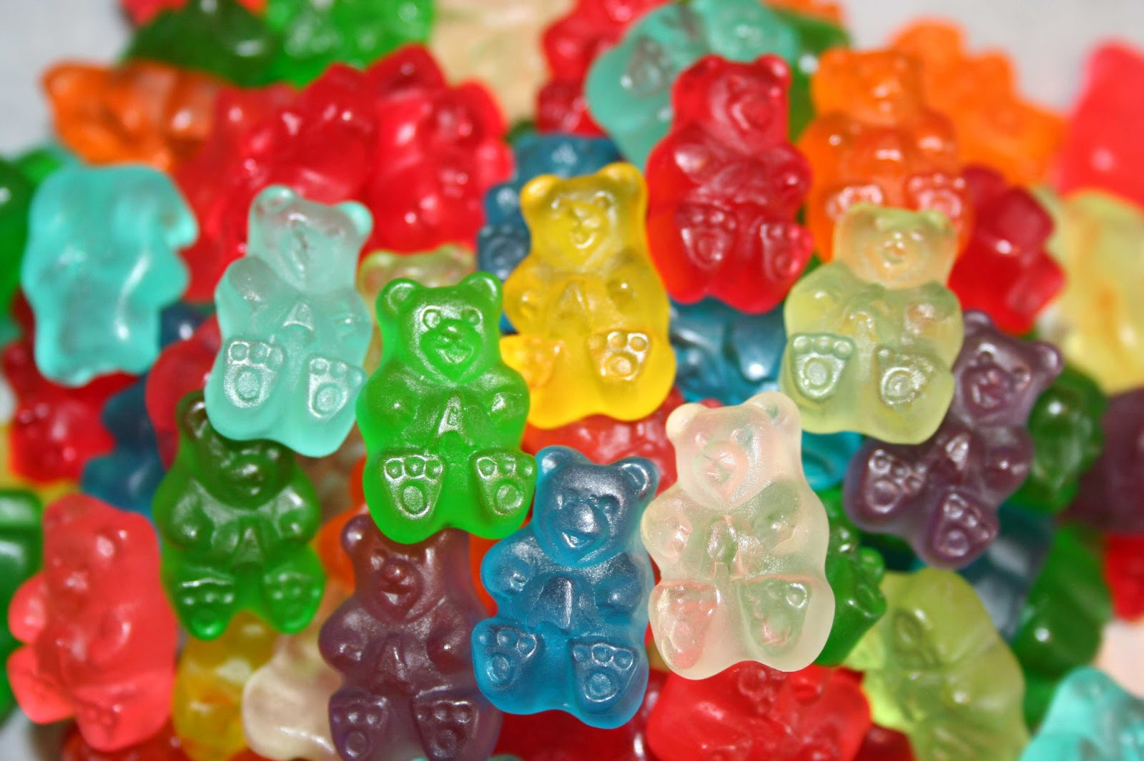
EDIBLE
CANNABIS
MILTON KEYNES
YOUNG PEOPLES
DRUG AND ALCOHOL SERVICE

Slide 2
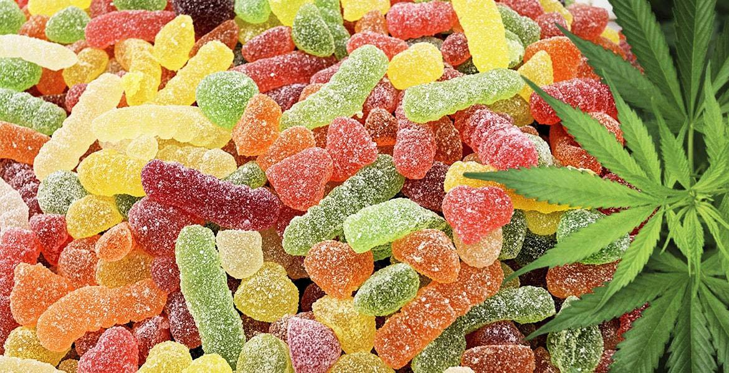
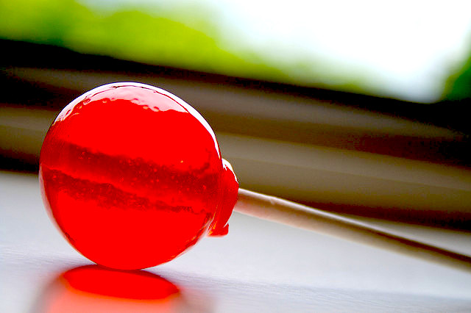
WHAT IS EDIBLE CANNABIS ?
Edibles refer to food and drink products that contain cannabinoids, the intoxicating compounds found in cannabis, primarily THC
You may have heard of brownies and cakes containing cannabis, but there are a growing selection of sweets, such as gummies, nerd ropes
There are also cannabis infused syrup drinks referred to as THC lean.
The availability of these sweets and drinks appears to be increasing across the whole country
Packaging is often deliberately targeted to attract young people and looks similar to well-known sweets such as Haribo, Smarties, Nerds, Fanta and chocolate bars

Slide 3
RISKS
Edibles look like sweets and can be easily mistaken for these by younger children, who may not know they contain cannabis.
When someone smokes cannabis the effects are felt almost immediately, however when you eat or drink cannabis it may take 30 minutes or more for effects to be felt. Young people may think they need more, which could lead to overdose
The effects from edibles are often more intense and take longer to wear off, which may lead to individuals feeling sick, having an increased heart rate, cognitive impairment, agitation, anxiety or psychosis and requiring medical assistance.
Lean made popular in rap culture is a mixture of codeine (an addictive opiate based substance), fizzy drink and sweets, THC Lean may not contain codeine, however this does not mean it is a safer version as you can`t tell exactly what it does contain.
Unless the packaging has clear and accurate instruction`s there is no way of knowing how much cannabis is present, and how much is safe to take. Amounts in these products can vary greatly, and be made by people who know little about substances in DIY conditions.
As with any substance brought from streets or online, edibles may contain chemicals other than cannabis
There have been reports of young people being hospitalised in London and the South East due to using edibles.
Cannabis is illegal in the UK, there is a risk of young people becoming involved in the criminal justice system.
Edible sweet packets can cost around £15 – 20.

Slide 4
Health Risks
Increased heart rate and blood pressure
Vomiting
Dry mouth
Bloodshot eyes
Confusion and poor coordination
Paranoia
Hallucinations
Panic attacks
Impaired brain development
Impact on mental health
Psychosis

Slide 5
Information to share with young people
Edibles look like normal sweets and imitate popular brands such as Haribo, Nerds and Sourpatch. To spot them, look at the packaging carefully
If you come across edibles, speak to an adult
If used regularly cannabis in any form can have a negative impact on your mental health, education and future employment
If you are worried about someone who may have taken edibles call an ambulance
Cannabis is a class B drug, the maximum prison sentence for possession is 5 years, an unlimited fine or both.
Supplying someone even your friends, the maximum prison sentence is 14 years, an unlimited fine or both.
If you are convicted of possession of an illicit drug many countries in the world such as the USA, Australia and New Zealand will not allow you a visa to visit.

Slide 6
Information for young people if they choose to use drugs or alcohol.
Always smoke, eat or drink a small amount of any substance at first in case it is stronger than you are used to, or has had something dangerous added to it to `bulk it up`.
If you are smoking cannabis don’t breathe the smoke in too deeply, this will only damage lungs and won`t increase the effect.
Use somewhere you feel safe and with people you trust.
Have someone you trust with you who will stay drug/alcohol free in case of emergency
If you think someone has taken something and you are worried call an ambulance, don’t leave them to sleep it off

Slide 7
Information for young people if they choose to use drugs or alcohol.
Remember these things may affect your experience when using drugs or alcohol:
Your mental state, how you are feeling
The environment, where you are
Who you are with
What chemicals the substance has in it

Slide 8
What you can do as adult
Speak to young people about edibles so they are aware of these and the dangers of consuming them.
Monitor food packaging/wrappers, looking for images of cannabis leaves or wording such as CBD or THC suggesting the items are cannabis oil infused.
If you are made aware of any social media accounts advertising these items, please report this information to the police or crime stoppers.

Slide 9
What you can do as adult
Build a trusting relationship with young people that you are worried about. Has there been a sudden change in behaviour? Have they changed friendship groups or become less bothered about their appearance?
For further advice, speak to the local drug and alcohol service
If you believe that a young person may have consumed edibles and is experiencing a reaction, call an ambulance

Slide 10
Who you can contact:
Young Peoples Drug and Alcohol Service - support for young people aged 18 and under. As part of our work we enable young people to understand the risks and harm of taking drugs or drinking alcohol.
E-mail: https://www.childrenssociety.org.uk/information/young-people/east/EYPDAS
Tel: 03003037000
Talk to Frank – the government’s drug advice website/helpline including information and advice for parents on how to talk about drugs with their children
KOOTH – mental health support and advice for 11-19 year olds, available 365 days a year
Young Minds Parents Helpline – 0808 802 5544 (Mon – Fri 9:30 -16.00)
SHOUT – text SHOUT to 85258 24/7 free text service for anyone in crisis anywhere

