Slide 1
Deep Impact
Lesson 4 – Near Earth Objects

Slide 2
Objectives
Be able to recall that asteroids and comets that come close to Earth are called Near Earth Objects or NEOs.
Be able to explain that astronomers can predict if a NEO will hit Earth by studying its orbit/path.
Be able to recall that the longer they study an NEO the more accurate their prediction.

Slide 3
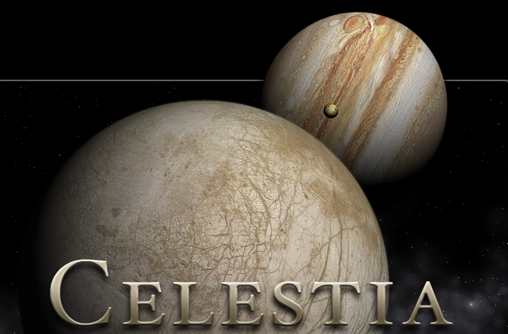
Near Earth Objects
Near Earth Objects are asteroids and comets that come close to our planet
Astronomers on Earth watch them closely using telescopes
They can calculate how fast they are moving and in which direction

Slide 4
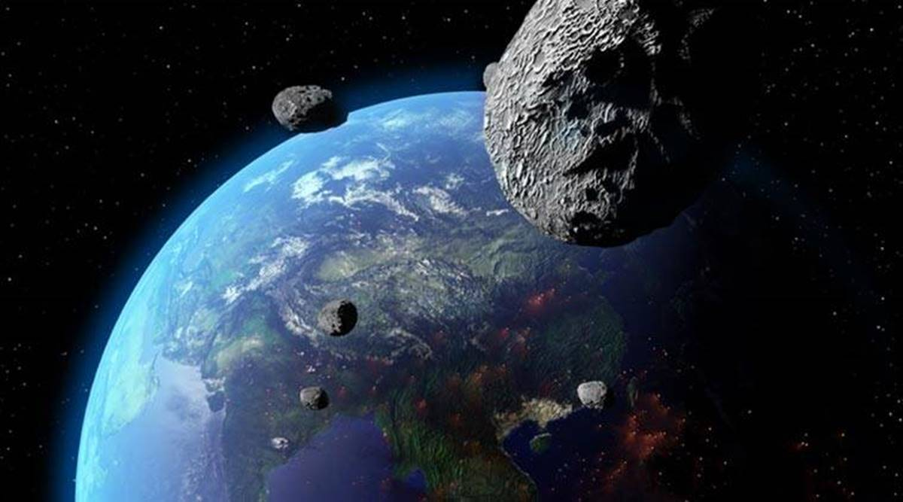

Slide 5
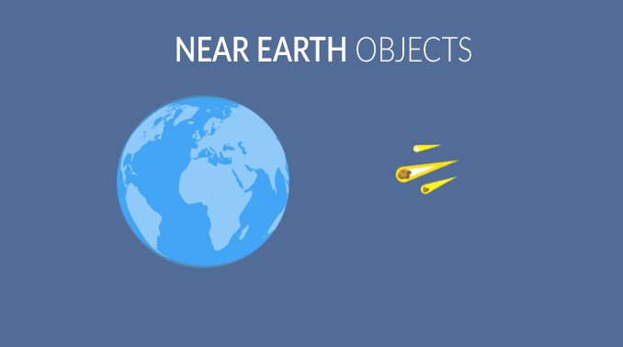
A bit of reading …

Slide 6
How did we do?
Be able to recall that asteroids and comets that come close to Earth are called Near Earth Objects or NEOs.
Be able to explain that astronomers can predict if a NEO will hit Earth by studying its orbit/path.
Be able to recall that the longer they study an NEO the more accurate their prediction.

